Slide 1
The threat to student privacy: NYS & NYC sharing confidential student and teacher data with inBloom Inc.
For Brooklyn Town Hall meeting
April 29,2013
Prepared by Leonie Haimson,
Class Size Matters

Slide 2
NYS & 7 other states plan to share confidential student data with inBloom Inc.
NYS and NYC sharing confidential student and teacher records with inBloom Inc., funded by Gates ($100 million) & Carnegie Foundations.
Other states participating in Phase I only involve “pilot” districts: North Carolina (Guilford Co.), Colorado (Jefferson Co.), Illinois (Unit 5 Normal and District 87 Bloomington) and Massachusetts (Everett).
NYS only Phase I state sharing student data statewide.
Phase II states include Delaware, Georgia, and Kentucky, starting date unknown.
Louisiana was going to share data statewide but pulled out of inBloom entirely because of protests of parents and school board members.

Slide 3
Who is inBloom?
Stacey Childress VP, Gates: headed project when SLC; former board member of Wireless, Harvard Business School lecturer & co-founder of software company.
Joel Klein, head of Wireless/Amplify: former NYC Chancellor.
Iwan Streichenberger, inBloom CEO: former marketing director of Promethean, company that sells whiteboards.
Sharren Bates, inBloom CPO: former DOE project director for ARIS.

Slide 4
What is inBloom doing?
inBloom is collecting student names, grades, test scores, detailed disciplinary & health records, race /ethnicity, economic and disability status.
The information will be stored on a data cloud operated by Amazon.com.
Gates paid at least $44 million to Wireless Generation to build operating system. Wireless part of Rupert Murdoch’s NewsCorp.
inBloom, Inc. plans to share data with district consent with for-profit companies to help them develop and market their “learning products.”

Slide 5
Timeline
June 8, 2011: Daily News reports that NYSED is proposing no-bid contract with Wireless Generation to built its student data system.
June-August 2011: Parents & advocacy groups protest because of privacy concerns (Wireless/NewsCorp) & conflict of interest (Joel Klein’s involvement).
Aug 25, 2011: NY Comptroller vetoes NYSED’s no-bid contract with Wireless, because of threat to privacy.
December 13, 2011: the NY Regents approve NYSED plan to share data with the Shared Learning Collaborative, with operating system built by Wireless.
February 2013: The SLC becomes inBloom Inc.

Slide 6
What about security?
In recent survey, 86% of technology experts say they do not trust clouds to hold their organization’s “more sensitive” data.*
inBloom’s security policy states they “cannot guarantee the security of the information stored in inBloom or that the information will not be intercepted when it is being transmitted.”
All this is happening without parental notification or consent.
*Lieberman Software's 2012 Cloud Security Survey

Slide 7
Financial incentives to participate
Gates is giving millions of dollars in grants to districts that agree to share their data.
inBloom is traveling the country, offering cash prizes to tech companies to build their software around this data.
Ultimate goal: to commercialize the data & provide a thriving market of “learning tools” based on this very valuable & highly confidential info.

Slide 8
Issue of consent or opt out
October 2012: Stacey Childress of Gates Foundation writes on the Shared Learning Collaborative webiste: “…Under federal law, school districts must manage and honor parent requests to opt out of programs that require the use of student data.” Statement later removed from website.
February 2013: inBloom website : “School District and State Educational Agency Customers are responsible, as appropriate, for determining and notifying parents of policies regarding the extent to which parents (or students 18 and over) are given advance notice of, and the opportunity to decline, the provision of PII for their children (or themselves) to a Third Party Application Provider that uses the PII to provide educational services to schools or students. ”
March 2013: Tom Dunn, NYSED spokesman to Village Voice reporter about plan to provide statewide student data to inBloom for their “Education Data Portals {EDPs]”: “I'm not sure there's consent involved. This is regular student information that when parents register a child for school. They give up….”
April 2013: NYSED memo to districts: “NYSED is not aware of additional disclosure, notification, or opt out requirements for districts supplying data for tools that directly support instruction and program improvement like those currently provided in school districts and those provided in the EDP.”

Slide 9
What about privacy?
In UK and US, News Corp has been found to illegally violate the privacy of individuals.
If this data was regulated by HIPAA (Health Insurance Portability and Accountability Act) or COPPA (Children’s Online Protection Act) it could not be shared without parental consent.
FERPA (Family Educational Rights and Privacy Act) which regulates the privacy of educational records has been severely weakened by US Dept Ed.
Lawsuit in federal court against US Dept of Ed for rewriting regulations of FERPA to violate original intent of law.

Slide 10
Considerable costs & risks to states/districts
Starting in 2015, inBloom says it will start charging states/ districts for services.
InBloom says districts will be expected to pay $2-$5 per student, not counting fees paid to vendors.
For NYC this would mean at least $2M per year; NYS more than $5M per year.
The potential cost of class action lawsuits is greater, if data leaks out or is used inappropriately, esp since inBloom & Gates have tried to insulate themselves from legal liability.
inBloom also “exploring” charging vendors for accessing this private data; isn’t this “paying for data”?

Slide 11
Risks to student privacy even greater
The highly sensitive data that inBloom is collecting includes students’ detailed health, disciplinary, arrest & special education records.
The info being collected includes data from 1996 onwards, with the intention of tracking students over time.
If this information leaks out or is used inappropriately could damage child’s prospects for life.

Slide 12
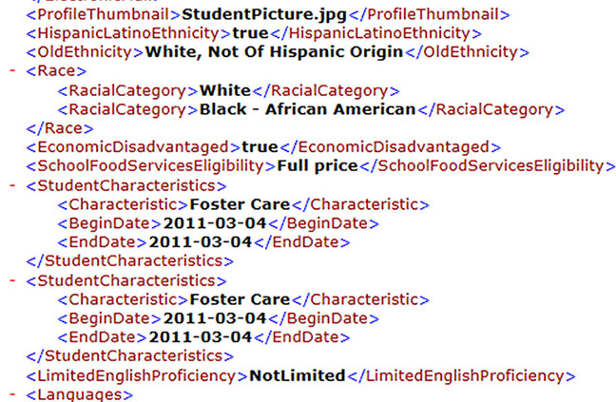
Sample racial, economic, language & foster care data to be shared with inBloom, Inc.
Source: https://www.inbloom.org/sandbox

Slide 13
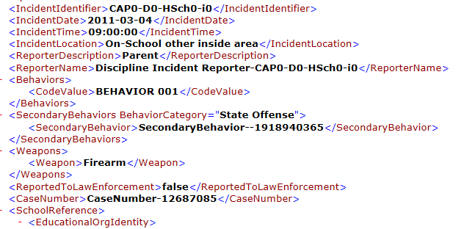
Sample disciplinary data being collected by inBloom
Source: https://www.inbloom.org/sandbox

Slide 14
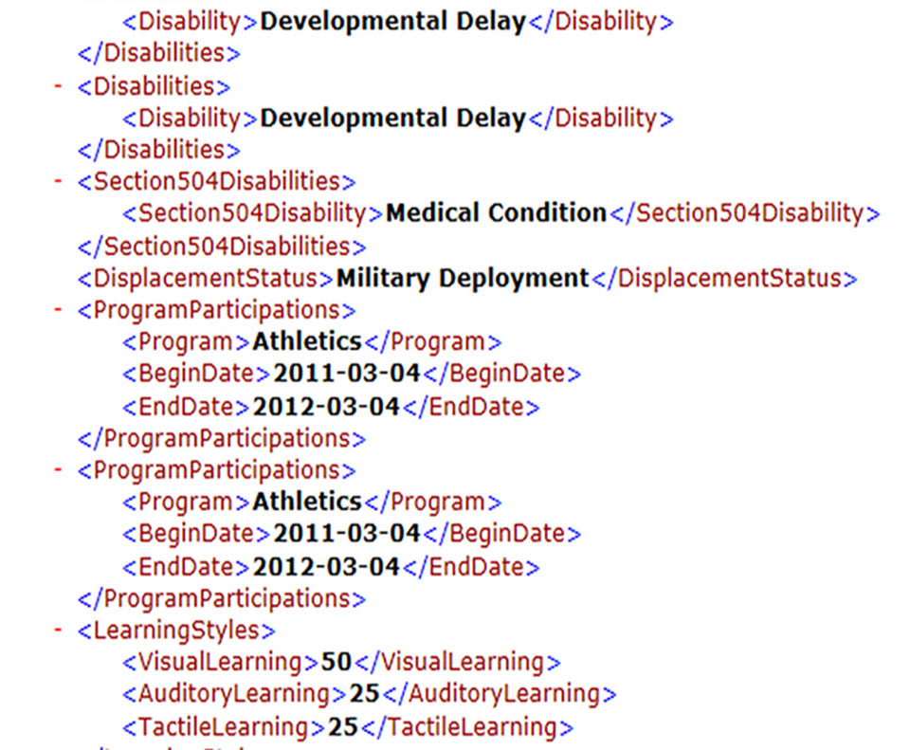
Sample disability & medical data collected by inBloom, Inc.
Source: https://www.inbloom.org/sandbox

Slide 15
inBloom also collecting confidential teacher data
Including name, SS#, address, linked to student test scores and other records.
Whether teacher was fired or excessed, and if so, for what reason & whether voluntary or not.
In future, states could agree to share data, highlighting those with low “value-added” test scores or problematic histories.
This could create a “blacklist” making it difficult for teachers to get jobs if moving out of state.

Slide 16
Sample teacher data to be shared with inBloom; reason for leaving job
Employment in education
Employment outside of education
Retirement
Family/personal relocation
Change of assignment
Formal study or research
Illness/disability
Homemaking/caring for a family member
Layoff due to budgetary reduction
Layoff due to organizational restructuring
Layoff due to decreased workload
Discharge due to unsuitability
Discharge due to misconduct
Discharge due to continued absence or tardiness
Discharge due to a falsified application form
Discharge due to credential revoked or suspended
Discharge due to unsatisfactory work performance
Death
Personal reason
Lay off due to lack of funding
Lost credential
Unknown
Other
Source: https://www.inbloom.org/sandbox

Slide 17
Though risks to privacy great, benefits hypothetical
InBloom & states say that this project will lead to greater efficiency, data integration, and more “personalized” learning tools.
Vicki Phillips of the Gates Foundation calls it an “amazing” new software program that is like a “huge app store … with the Netflix and Facebook capabilities we love the most.”
NYC DOE spent $80M on ARIS data system; same claims were made that it would greatly improve instruction, yet rarely used and now considered a boondoggle.

Slide 18
What can parents do?
Call your NYS Assemblymember & State Senator; ask them to co-sponsor bills to protect student privacy, A6059 and S04284.
Ask your CEC, Community Board, President’s Council, or PTA to pass resolution to support the bill; we have a sample on our website.
Send an opt out letter to Commissioner King & Chancellor Walcott, demanding your child’s info NOT be shared; see our website for a sample letter.
Sign up for Class Size Matters list serv and/or inBloom privacy newsletter.
If you have questions, email us at info@classsizematters.org

