Slide 1
inBloom, Inc. and data-sharing: The Threat to Student Privacy and Safety
Leonie Haimson, Class Size Matters
March 2014

Slide 2
What is inBloom Inc.?
inBloom Inc. non-profit corporation funded with $100M from Gates Foundation & Carnegie Corporation to collect, format and share personally identifiable student data with vendors.
Data uploaded onto a cloud operated by Amazon.com, with operating system built by Wireless Generation/Amplify, subsidiary of Rupert Murdoch’s NewsCorp..
NY RTTT districts told to sign up for “data dashboards” from 3 vendors, ConnectEDU, eScholar or NCS Pearson/Schoolnet, populated with data from inBloom cloud.
At least 40 districts returned RTTT funds but NYSED says their data will be uploaded anyway.
inBloom plans to commercialize this data, and w/ district consent, provide it to for-profit software vendors, to help them develop their “learning products.”

Slide 3
inBloom Timeline
May 5, 2011: NYSED sends letter to the State Comptroller, asking approval of a $27 million no-bid contract with Wireless Generation, to build state’s longitudinal student data system
June 8, 2011: Daily News reports on proposed contract. Controversy ensues as Wireless bought by Murdoch’s NewsCorp 6 months before, days after Joel Klein announced resignation from DOE to work at News Corp.
July 2011: News Corp engulfed in a huge scandal, including phone hacking in UK. CSM, NYSUT and others urge State Comptroller to reject contract based on privacy concerns.
Aug 9, 2011: My first HuffPo column on the multi-state Gates data collection project called the Shared Learning Collaborative, also with an operating system built by Wireless Generation for $44 million.
Aug 25, 2011: NY State Comptroller Thomas DiNapoli rejects Wireless contract: cites “significant ongoing investigations and continuing revelations with respect to News Corporation”
December 13, 2011: NY Board of Regents approves NYSED’s plan to share student data with Shared Learning Collaborative. Contract bypasses State & City Comptroller because no funds initially change hands.

Slide 4
Timeline (part II)
October 10, 2012: Class Size Matters and attorney Norman Siegel hold press conference, urging NYSED to hold hearings, disclose more info about plan, and give parents the right to consent before personal data shared with the Shared Learning Collaborative.
October 24, 2012: NYSED says no need for hearings since plans are “public knowledge” – yet few if any elected officials, parents, superintendents or school board members know anything about this.
October 29, 2012: Diane Ravitch publishes first of many blog posts on SLC, linking to our online petition to NYSED.
February 6, 2013: SLC becomes inBloom Inc.
March 3, 2013: Stephanie Simon of Reuters writes first national story about inBloom, on opening day of SXSW-Edu conference.

Slide 5
Within months, parents erupt in rage & 8 of 9 inBloom states pull out or put plans on hold
April 19, 2013: Louisiana Superintendent John White pulls data out of inBloom after protests from parent & teacher activists.
May 4, 2013: Georgia Superintendent assures parents that he will not disclose any student data to inBloom.
May 29, 2013: Reuters confirms Delaware, Georgia and Kentucky have no plans to share data with inBloom.
August 1, 2013: The only “pilot” district, in NC Guilford Co., pulls out of inBloom.
Nov. 7, 2013: After anti-inBloom slate of candidates sweeps election, Jeff Co. school board votes to withdraw & Colorado severs all ties to inBloom.
Nov. 26, 2013: Illinois says will keep data system separate from inBloom & allow districts to opt out; Chicago immediately pulls out.
Feb. 10, 2014: NYS Commissioner John King announces delay on the launch of data dashboards related to inBloom.

Slide 6
What information is being shared?
NY plans to share student names, addresses, phone nos., emails, grades, test scores & proficiency levels, ethnicity, economic, racial and disability status, health (504) conditions, attendance and suspension records.
Info to include each student’s’ records from day s/he enrolls in school till graduation, including up to 12 yrs of data for HS students.
After graduation, all data to be transferred to State Archives for minimum of 8 years, with unclear restriction on access.
inBloom system includes data collection fields with even more sensitive information, including detailed health & pregnancy information, arrest records, family structure and immigration records.

Slide 7
What is inBloom’s goal?
InBloom claims that this project will lead to greater efficiency, data analysis and integration, and create a vibrant market in “personalized” learning tools – by allowing vendors to data-mine student information & create “interoperable” software programs.
Ken Wagner of NYSED says that service providers, tools and standards will converge in "a magic mix that hasn't come together before."
In NYC, the Department of Education spent $80M on ARIS data system, with data dashboards also built by Wireless Generation. Many of same claims were made, yet ARIS is rarely used and considered by many a boondoggle.

Slide 8
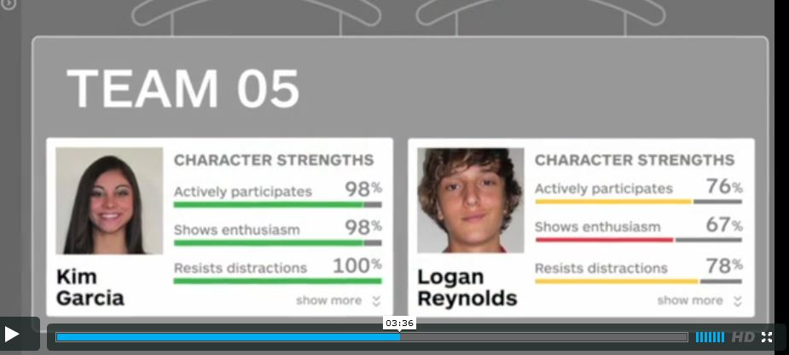
Dashboards will also include “warning flags” and “behavioral incidents” Sample dashboard from inBloom video

Slide 9
What about security?
In survey, 86% of technology experts say they do not trust clouds to hold their organization’s “more sensitive” data.*
inBloom’s security policy: they “cannot guarantee the security of the information stored in inBloom or that the information will not be intercepted when it is being transmitted.”
In April, the personal information of 50 million LivingSocial customers was disclosed when an Amazon.com cloud was hacked.
Last month, Target breach affected up to 110 million customers.
*Lieberman Software's 2012 Cloud Security Survey

Slide 10
What about privacy?
Though NYSED claims inBloom FERPA-compliant, Family Educational Rights and Privacy Act regulating privacy of educational records.
FERPA regs weakened by US Dept of Ed in 2009 and 2011 to encourage data sharing with contractors & “authorized agents” without parental consent.
US Dept of Ed was sued in federal court for rewriting FERPA in way violates original intent and language of law.
The same data stored in child’s health records or gained through online usage could NOT be shared with any 3rd parties without parental consent, acc. to HIPAA (Health Insurance Portability and Accountability Act) or COPPA (Children’s Online Protection Act)

Slide 11
Issues with the dashboards -- even if there are no breaches
Minor incidents will now enter into a student’s permanent record and be easily accessible to teachers and others through the dashboards.
Research shows that teachers tend to stereotype students based on prior knowledge and that this can become a self-fulfilling prophecy.
If dashboards reveal details in an academic or disciplinary history before teachers have met students, this can create negative expectations that seriously impair their prospects.

Slide 12
Data collection/connection with Common core
With uniform tests and test score data across nation, multi-state databases more valuable to vendors & groups like Gates Foundation.
Through federal stimulus funds & RTTT, US Dept of Ed pushed states to create longitudinal “cradle to grave” data systems
These systems supposed to collect info on children among many state agencies and provide it to researchers and others.
PARCC & SBAC testing consortia poised to become inBloom-like, multi-state databases collecting and sharing personal data w/o parental knowledge or consent.

Slide 13
Post inBloom…
Parents need to know exactly what districts are already doing w/their children’s private data.
Every parent should ask their principal &/or Superintendent what personal data is being disclosed to which 3rd parties & under what conditions.
With growth of online learning & Common Core standards, student data is now incredibly valuable
K12 education $500 billion potential market that vendors eager to get their hands on.

Slide 14
Other examples
ALEC bills: Student Achievement Backpack Act wd provide “a complete learner profile” stored on a data cloud and “managed by the State Office of Education” which would follow “the student from school to school.” Parents would have no authority over who accessed their children’s data
“Student Futures Steering Committee" members appt by Governor, to collect student data across agencies and “administer and manage Student Futures in collaboration with the Department of Workforce Services, the State Board of Regents, and the State Board of Education” to steer kids into appropriate careers.
Code.org , asking for 7 yrs of personal data in exchange for free software & PD.

