Slide 1
The crisis in NYC class sizes & threat to student privacy
Presentation to Community Education Council District 27
Spring, 2013
Leonie Haimson, Class Size Matters

Slide 2
Why is class size important?
Class size reduction one of 4 reforms proven to work through rigorous evidence, acc. to Inst. Education Sciences, research arm of US Ed Dept. *
Benefits esp large for disadvantaged & minority students, very effective at narrowing the achievement gap.
NYC schools have largest class sizes in state;
2003, NY’s highest court said students denied constitutional right to adequate education in part due to excessive class sizes (Campaign for Fiscal Equity decision).
86% of NYC principals say cannot provide a quality education because of excessive class sizes.
Smaller classes top priority of parents on DOE learning environment surveys every year.
*Other three K-12 evidence-based reforms, are one-on-one tutoring by qualified tutors for at-risk readers in grades 1-3, Life-Skills training for junior high students, and instruction for early readers in phonemic awareness and phonics.

Slide 3
Stagnant achievement in NYC schools under Bloomberg
NYC students have fallen further behind their peers in other large cities, according to national assessments (NAEPs), coming in 2nd to last in progress since 2003;
NYC also only large district where non-poor students have lower NAEP average scores than in 2003.
Only 21% of NYC HS grads are considered “college ready”; 13 – 15% of Black and Hispanic students;
Students needing triple remediation* at CUNY have doubled in last 5 years.
* Triple remediation means make-up classes in reading, writing & math.

Slide 4
Contracts for Excellence
In April 2007, NY State settled the Campaign for Fiscal decision by passing the Contracts for Excellence (C4E) law.
State agreed to send billions in additional aid to NYC & other high needs school districts; to spend in six approved areas, including class size reduction.*
In addition, NYC had to submit a plan to reduce class size in all grades.
In 2007, the state approved DOE’s plan to reduce class sizes on average to 20 students per class in K-3; 23 in grades 4-8 and 25 in core HS classes.
In return, NYC has received more than $2.5 billion in cumulative state C4E funds since 2007.
*other allowed programs include Time on Task; Teacher & Principal Quality; Middle & HS Restructuring; Full-Day Pre-K; & Model Programs for English Language Learners

Slide 5
City’s class sizes have risen sharply in all grades since 2007…esp. in K-3; now largest in 14 yrs!
This year’s class size data is available at http://schools.nyc.gov/AboutUs/data/classsize/classsize.htm
*All class size figures calculated averaging Gen.Ed, CTT and G&T November reporting.

Slide 6
What happened in D27?

Slide 7
Also in grades 4-8, class sizes have increased

Slide 8
Also in HS: citywide average class sizes have risen
*There is no November reporting for the 2007-08 year, data used is from Feb. report

Slide 9
Ways that DOE has worked AGAINST reducing class size
Since 2007, DOE has cut school budgets 14%– contradicting C4E prohibition against supplanting.
In 2010, DOE eliminated Early grade class size funding– despite promise in C4E plan to keep it.
In 2011, DOE decided no longer to cap class sizes in 1st-3rd grades at 28, leading to tripling of class sizes 30 or more in these grades.
In 2012, DOE instructed principals to accommodate special needs students up to contractual class size maximum.
DOE has never aligned either “Blue Book” formula or capital plan to goals in class size plan, as required by state law.

Slide 10
CFE funding also flat-lined; but even when increased; city’s class sizes grew!

Slide 11
Loss of teachers while DOE had other priorities
Number of pedagogues (mostly teachers) has been cut by more than 5,000 since 2007, despite rising enrollment. *
Smallest # pedagogues in 2011 employed by DOE since 2003.
Largest # non-pedagogues in 2011 employed since at least 1980.
Highest % of non-pedagogues to pedagogues since 1993.
Spending on testing, contracts, consultants, and more bureaucrats have all risen sharply.
(*Data source: Office of Management Budget headcounts, through IBO)

Slide 12
But can we afford to reduce class size?
In 2009, DOE estimated that it would cost $358 million per year to achieve average C4E class size goals across the city;
DOE estimated it would cost $448 million per year in staffing to achieve class size goals in ALL schools; plus more in capital costs for school construction.
This year, NYC received more than $530 million in C4E funds.

Slide 13
Other questions re city’s C4E plan
Why did the DOE not centrally devote ANY C4E funds to class size reduction, given its legal obligation to lower class size?
DOE finally posted C4E plan for this year only in Feb., and holding hearings now, though funds mostly spent, making mockery of public feedback and process required in law.
Is DOE’s C4E plan for last year (2011-12) yet approved by the state ? If so, where is it posted?

Slide 14
NYS & NYC also violating student privacy and parental rights
9 states/districts including NYS sharing confidential student and teacher data with inBloom Inc., private corporation funded by Gates Foundation.
Data includes student names, grades, test scores, disciplinary & attendance records, race /ethnicity, economic status, disability and health issues.
Data will be stored in a massive electronic data bank, built by Wireless Generation, run by Joel Klein & owned by Rupert Murdoch of News Corporation.
NewsCorp found to illegally spy and/or violate privacy in UK and US.

Slide 15
Then what?
inBloom, Inc. plans to put this sensitive data on a cloud run by Amazon.com and transmit it to for-profit companies to help them develop and market their “learning products.”
In recent survey, 86% of IT experts say they do not trust clouds to hold their organization’s sensitive data.
In its security policy, inBloom Inc. states they “cannot guarantee the security of the information stored in inBloom or that the information will not be intercepted when it is being transmitted.’
All this is happening without parental notification or consent.

Slide 16
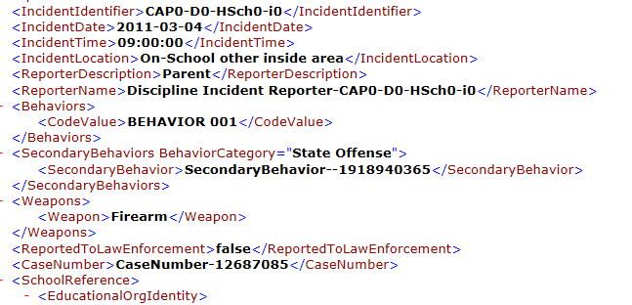
Sample data to be shared with inBloom, Inc.

Slide 17
What can CEC’s do?
Pass resolutions on class size and privacy; we have samples for your consideration.
Write a letter to Commissioner King, to protest the botched C4E process & DOE’s failure to reduce class size at jking@mail.nysed.gov
Send comments to contractsforexcellence@schools.nyc.gov; deadline March 18.
Collect information about class sizes in your district’s schools, including violations of union contract & building code.
Parents should send opt out letter to King, demanding your child’s info NOT be shared; see our fact sheet for a sample letter.
Questions or to join newsletter list, email us at info@classsizematters.org

