Slide 1
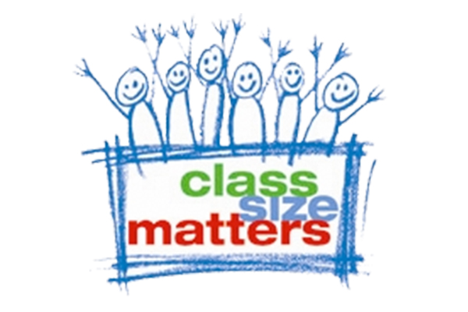
Class Size Trends for Staten Island 2006-2019
Class Size Matters
www.classsizematters.org
Info@classsizematters.org

Slide 2
In 2007, NYS Legislature passed a new law called the Contracts for Excellence (C4E)

Slide 3
C4E law states that in return for millions in new state funding, NYC has a legal obligation to: 1. Spend the funds to improve school conditions in six specified areas. 2. Create a plan to reduce class sizes in all grades over five years. 3. In 2007, NYC submitted a 5-yr plan to reduce class sizes to no more than 20 in grades K-3; 23 in grades 4-8 and 25 in core HS classes. 4. Yet instead of decreasing, class sizes increased sharply, starting in 2008.

Slide 4
D31 Class Size Trends
18.5% increase in K-3rd class size since 2006
2.4% decrease in 4th-8th class size since 2006
K-3rd class sizes were larger than the C4E goal in 2006 by 0.1 students per class, and are now larger than the C4E goal in 2019 by 5.3 students per class
4th-8th class sizes were larger than the C4E goal in 2006 by 3.3 students per class, and are now larger than the C4E goal in 2019 by 5.3 students per class

