Slide 1
Class Size Trends Citywide & Other Related Issues 2007-2019
Leonie Haimson and Emily Carrazana
Class Size Matters
11/20/10
www.classsizematters.org
Info@classsizematters.org

Slide 2
What are the UFT contractual class sizes limits?
25 students per class in Kindergarten
32 students per class in grades 1st-5th grades
In Title I MS, 31 students per class in 6th-8th grades , 33 in non-Title one schools
34 students per class in high school core academic classes
These class size caps have not been lowered in 50 YEARS!
Even so, hundreds of classes violate the union contractual caps each year.

Slide 4
In 2007, NYS Legislature passed a new law called the Contracts for Excellence (C4E)

Slide 5
C4E law states that in return for millions in new state funding, NYC has a legal obligation to: 1. Spend the funds to improve school conditions in six specified areas. 2. Create a plan to reduce class sizes in all grades over five years. 3. In 2007, NYC submitted a 5-yr plan to reduce class sizes to no more than 20 in grades K-3; 23 in grades 4-8 and 25 in core HS classes. 4. Yet instead of decreasing, class sizes increased sharply, starting in 2008.

Slide 6
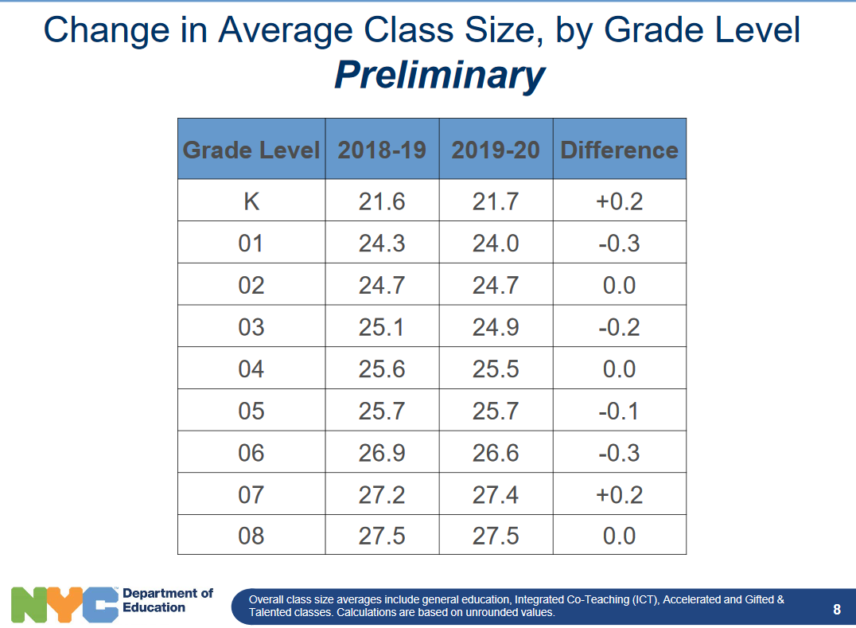
This year’s class size data was just released and shows a small increase in average class sizes citywide in Kindergarten and 7th grade;
other grades no change or small decreases.

Slide 10
But average class sizes only tell part of the story! The total number of students in classes of 30 or more citywide has also increased since 2007.

Slide 15
School overcrowding also an issue in many districts
Latest Blue Book for 2018-2019 shows that there were 515,898 students in NYC overcrowded schools
Though in some districts, there would be space to lower class size right now.

Slide 16
So what are we doing about this?
In July 2017, CSM along with 9 NYC parents & AQE filed a complaint with the State Education Commissioner to demand they enforce the C4E and require NYC to lower class size.
In April 2018, after the Commissioner ruled against us, so we followed up with a lawsuit vs. the city and the state in the NYS Supreme Court.
Though Judge Henry Zwack ruled that the Commissioner’s decision to allow NYC to increase class size should be given deference, we appealed the case to the Appellate Court in May 2019.
Hearings will be held at the NY Appellate Court in Albany in January 2020.
.

Slide 17
What does DOE say in court, in arguing they don’t need to lower class size?
DOE claims that then-Commissioner Steiner gave them a waiver from reducing class size in 2010.
BUT: Commissioner Steiner clearly stated this was a temporary waiver, due to the economic recession which ended a decade ago.
In any case, neither Steiner nor the current Commissioner has the authority to waive the law.
The DOE also argues that any class size obligations lapsed at the end of the 2011-2012 school year; even though the state legislature renews the C4E law every year, including the part of the law requiring NYC to lower class size.
DOE also claims though they may have had an obligation to create a plan, they didn’t have to follow it!

Slide 18
What else are we doing?
We had a campaign last year to urge the City Council to allocate dedicated funding to be used to reduce class size, especially in struggling schools to begin with and in the lower grades.
We were unable to convince them but plan to push for this in next year’s budget.
Please join our campaign by passing a resolution and contacting your CMs to support this effort.

Slide 19
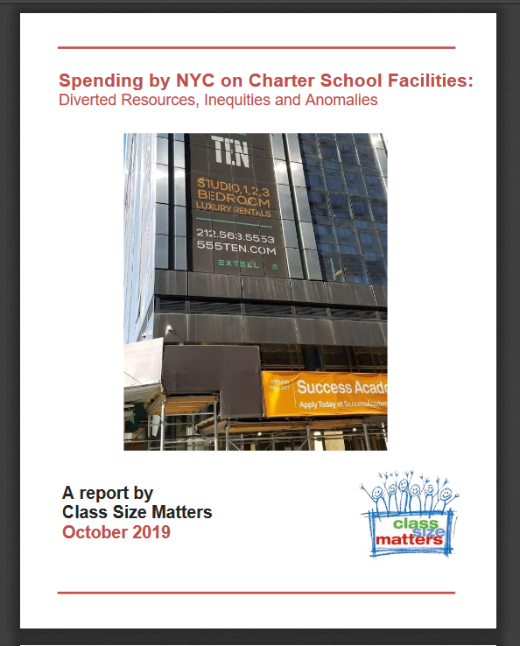
We also released a report on charter facility funding last month.
State law passed in 2010 requires matching funds for facility upgrades for public schools co-located with charter schools, for every expenditure by charters for facility renovations over $5000.
We found that FY 2014 to FY 2019, about $22.1 million in charter school expenditures on facility upgrades were not matched in the public schools that shared their buildings, a shortfall of about 14%

Slide 20
Notes:
Report Figure 3

Slide 21
In 2014, the state passed a law stating that NYC must either provide charter schools space in public school buildings or help them pay for private space
NYC is the only district in the state and the country with this legal obligation.
We found that the cost of leasing private buildings for charters and providing them a per-student subsidy to allow them to rent their own buildings has risen sharply, and was over $100 M last year;
This annual amount if used to finance the school capital plan could fund a 50% increase in school seats to be built to relieve overcrowding.

Slide 22
We also found that DOE is helping to pay for 8 Charters though their buildings owned related parties
This means the building is owned by their charter management organizations or an affiliated LLC or foundation.
The total for such expenditures amounts to about $14.8 million in DOE expenditures since FY 2015

Slide 23
Examples: Success Academy Hudson Yards
DOE spent $2.2 million for two Success Academy charter schools in FY 2019 located in Hudson Yards complex on the west side of Manhattan, the most expensive real estate development in NYC.
Yet Success Academy Charter Management Organization purchased the space for $68 million in 2016, with at least $20 million donated by Robertson Foundation.
In another case, the city paid $461,965 in lease subsidies in FY 2019 towards the rental costs of Beginning with Children II charter school in Brooklyn.
Real estate records show Beginning with Children Foundation bought the building for only $10 in 2017 from the Pfizer Corporation.

Slide 24
Harlem Village Academy
Since FY 2015, the DOE has provided per-student lease subsidies of nearly $3.2 million to Harlem Village Academy – West (M335) for an elementary school located on 74 West 124th Street.
The building was purchased in 2012 by “HVA 124 LLC” for $13 million according to property records, a limited liability company in which the HVA CMO is the sole member. This was before the charter amendment requiring subsidies was passed.
Jonathan Gray COO of Blackstone donated $10 million for the purchase of the building and an additional $15 million for building renovations.
Part of the renovation costs were also paid by federal New Market Tax credits.

Slide 25
Harlem Children’s Zone Promise Academy II
Since FY 2015, the DOE has provided approximately $2.1 million in lease subsidies to Harlem Children's Zone Promise Academy II Charter School (M341) in a building on 35 East 125th Street.
According to city records, this building has been owned by “Rheedlen 125th Street LLC” since 2000, which is a subsidiary of Harlem Children Zone network and their sole member.

Slide 26
Family Life Charter Schools
Family Life Charter Schools (FLACS) received $862,696 from DOE in lease subsidies in FY 2018.
FLACs was founded in 2000 in partnership with the Latino Pastoral Action Center (LPAC), headquartered in the same building on 14 West 170 St. in the Bronx.
Property records show the building is owned by LPAC and tax forms show that they receive rental income.

Slide 27
What are we doing about this?
We are urging the NYC Comptroller to audit this spending of matching funds to see that they are equitable and fair
And to look at DOE spending on leases for charter schools to see if we should be subsidizing the rent for charters that own their own buildings.
We are also advocating for the State Legislature to change the charter law to relieve DOE’s obligations to provide space for charter schools in public school buildings or pay for their rent in private spaces.
.

Slide 28
How you can help
Pass a resolution and/or contact the Comptroller urging him to audit the city’s spending on charter facilities and renovation matching funds;
Contact your state legislators to change the charter law to relieve DOE’s obligations to provide space for charter schools in public school buildings or pay for their rent in private spaces
For more information or to subscribe to our newsletter, check out our website at www.classsizematters.org or e-mail us at info@classsizematters.org

