Slide 1
Class Size Matters /NYC Kids PAC 2021 NYC Council Candidate Briefing December 9, 2020

Slide 2
Introduction – Who We Are
Only parent-led PAC focused on NYC public schools
Supports candidates for office who have demonstrated a commitment to improving NYC’s public schools
Produces annual Mayoral report card and issue candidate surveys
Co-sponsors annual Parent Action Conference with CSM
Non-profit org advocating for smaller classes in public schools, with focus on NYC
Class size reduction is a proven reform shown to improve outcomes for all students, especially disadvantaged kids & students of color
Also advocates for greater parent involvement in decision-making and stronger student privacy protections
Notes:
Class Size Matters: https://www.classsizematters.org/
NYC Kids PAC: https://nyckidspac.org

Slide 3
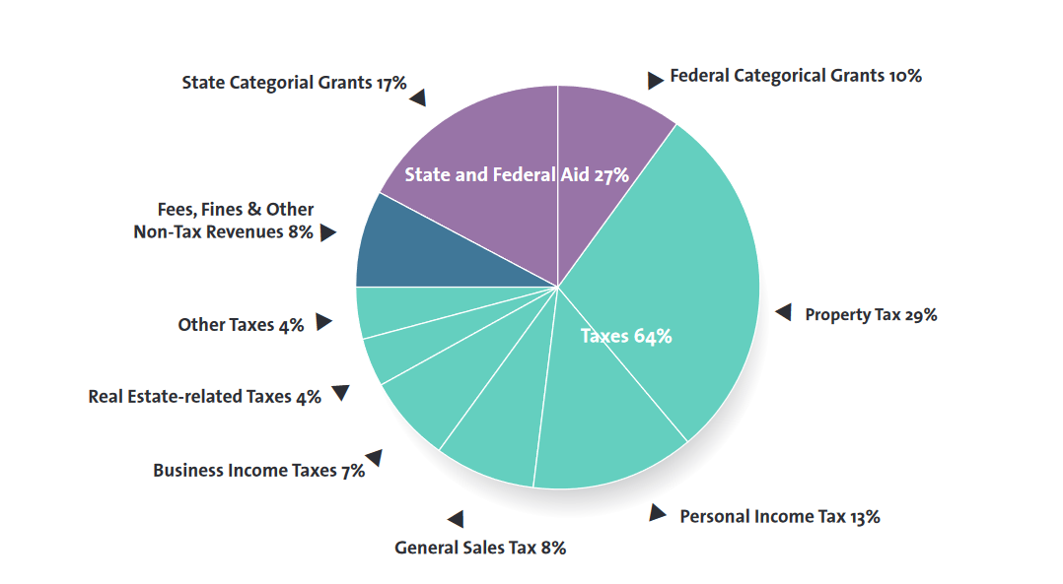
City revenue sources
Source: Independent Budget Office FY 2017

Slide 4
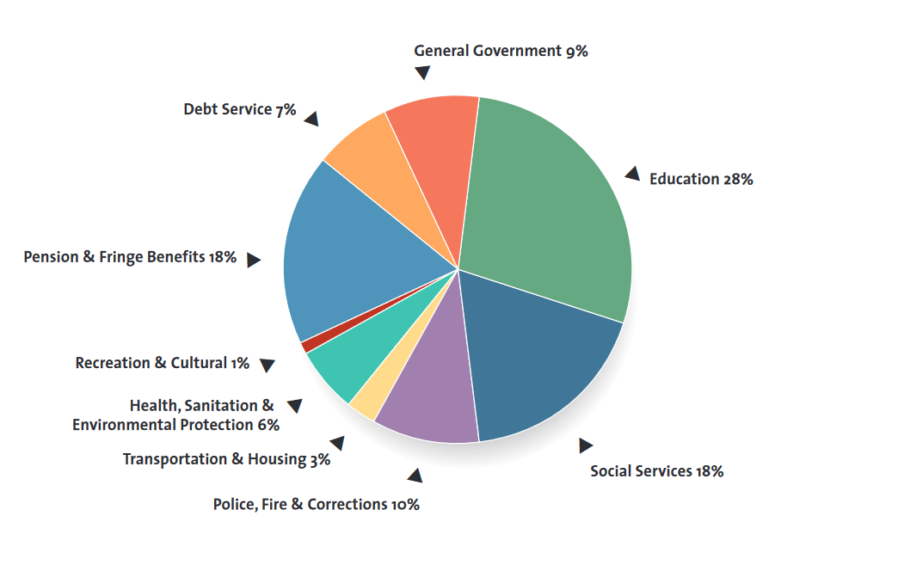
How is city revenue spent? Source: IBO, FY 2017

Slide 5
Debate over spending on education vs. police
Last spring, Mayor proposed $600 million in reductions to education budget, with $280M cut directly to school budgets.
Also, he imposed a staffing freeze except for School Safety Agents, trained & hired by NYPD, whose budget would increase
At the same time, there would be no cuts to the NYPD budget whose staffing & funding would continue to increase
There are over 5,500 School Safety Agents, more than the number of counselors, social workers and school psychologists combined.
After budget was negotiated, Mayor claimed that it included “$1 billion in cuts and cost shifts to the NYPD." Yet IBO says only about $4 20M was cut, including $330M for planned overtime (most of which will likely not occur),& $55M by eliminating hiring for summer class or 1,163 new recruits .
Mayor de Blasio also promised that over time, the budget for, hiring, supervision & training of School Safety Agents would pass from NYPD to DOE

Slide 6
NYC DOE Budget – Total & Sources (FY 2020)
Total NYC Department of Education budget = $34B
Most by far of any NYC city agency
Funding Sources:
New York City provides 57%
NY State provides 36%
Federal government and other sources provide 7%

Slide 7
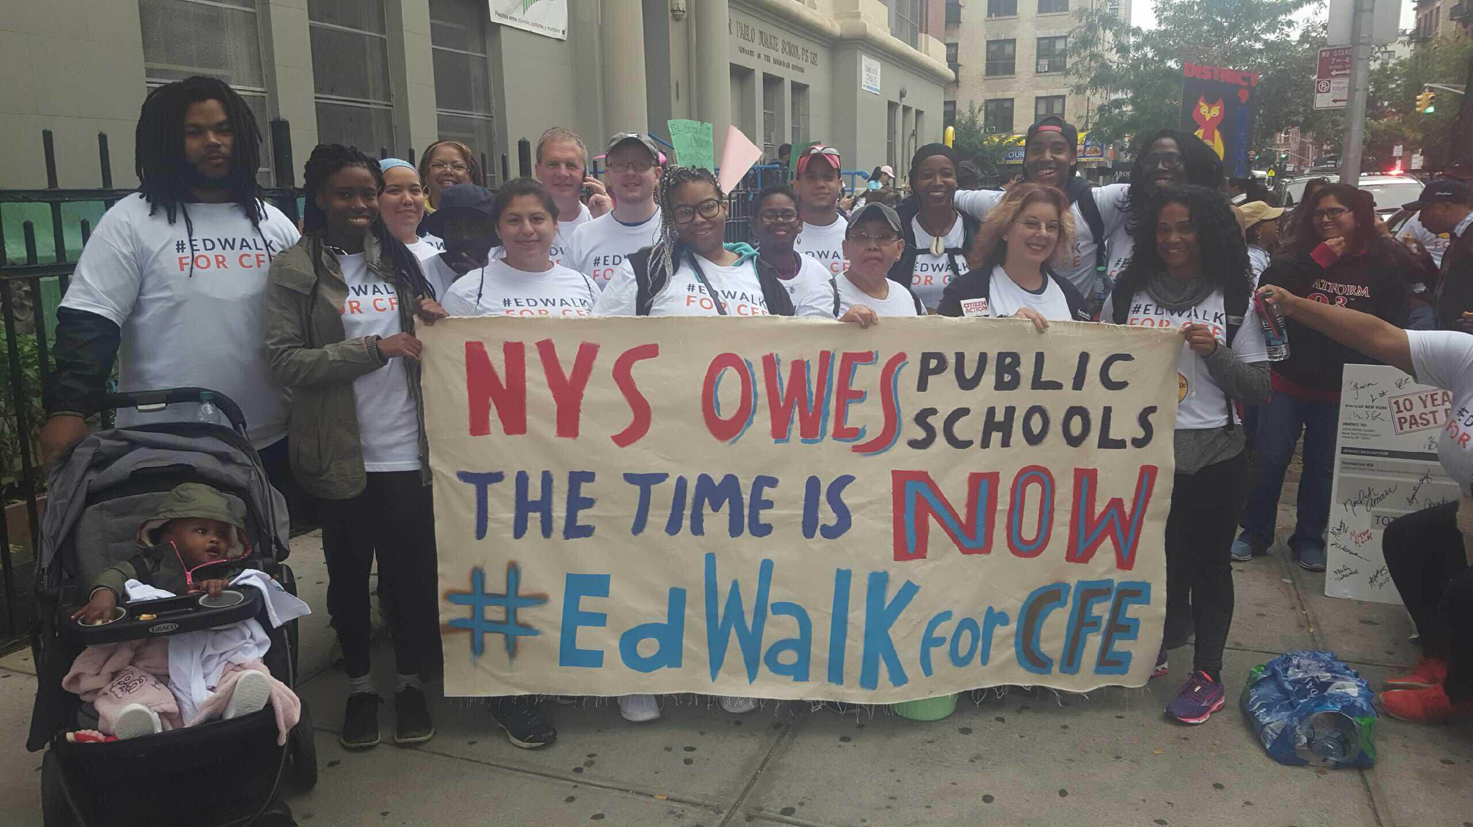
State Education aid is inequitable
NYC doesn’t receive fair share of state funding, especially as our schools have by far the most disadvantaged, Black & Latinx, English language learners, and special needs students in State
Court’s decision in Campaign for Fiscal Equity in 2007 found state violating law since our state Constitution required the state offer all children the opportunity for a “sound basic education”
Photo via Alliance for Quality Education

Slide 8
Research shows smaller classes provide important education and economic benefits
Smaller classes lead to better grades and test scores, stronger student engagement, fewer disciplinary referrals, less teacher attrition and higher graduation rates, especially for students who need help the most.
Class size reduction is one of only a handful of reforms shown through rigorous research to narrow the achievement gap between economic and racial groups.
Economists estimate that smaller classes yields economic benefits twice the costs; the benefits are especially large for low-income students and children of color.
Smaller classes in NYC schools would likely lead to substantial cost savings in terms of fewer special education referrals, less teacher training costs, less grade retention and higher four-year graduation rates as well.

Slide 9
Court decision and state law re class size
Major finding of CFE decision was recognition that NYC’s class sizes were much larger than the rest of the state
Contracts for Excellence law passed in 2007 requiring NY State to provide more funding to NYC & other high needs districts
NYC was also supposed to submit a plan to reduce average class sizes in all grades, plan approved in 2007
Plan never followed & instead class sizes increased and are still significantly larger than when the law was passed, especially in early grades

Slide 14
*Only HS students in social studies classes included to avoid double counting

Slide 17
City Council has less control over DOE & schools than other agencies/social services
Mayor makes education policy with very little input from City Council because of mayoral control which he gets from the state
DOE is unlike any other city agency because Council can’t make laws about policies and specific programs
Council does have input in three major areas help determine school options:
To approve the annual operating budget and the capital budget for schools
Hearings and Oversight and
Reporting bills & resolutions

Slide 18
Council approves DOE Operating Budget
Council annually negotiates an operating/expense budget for every agency
Can’t directly control exactly how funds are spent within DOE, but can negotiate MOUs or terms & conditions for certain programs
Examples: added $100M to Fair Student Funding in 2018, and restored funding for school counselors in 2020
Example: more than 20 yrs ago, Council allocated specific funding stream to cap class sizes at 28 in K-3 grades
Last year, before COVID–19 hit, Class Size Matters , Kids PAC & other groups pushed for $100M to be allocated specifically for class size reduction
Council held standing–room–only hearings in February 2020

Slide 19
Five-year school capital plan
City Council annually approves updates to the five-year capital budget for school repair, construction & modernization, financed via 30 yr bonds
Capital budget has increased in recent years, with $9B for school capacity projects, $6.4B for improvements and $3.6B for mandated projects.
State reimburses city for about 50% of payments on bonds
DOE claims current capital plan will eliminate overcrowding, but refuses to explain how they estimate needs for new seats
Over 500K students still attend overcrowded schools, based on DOE data
Average elementary school over 100% capacity, and MS/HS more overcrowded in recent years
School capacity formula aligned to large class sizes & NYC has largest class sizes in the state

Slide 20
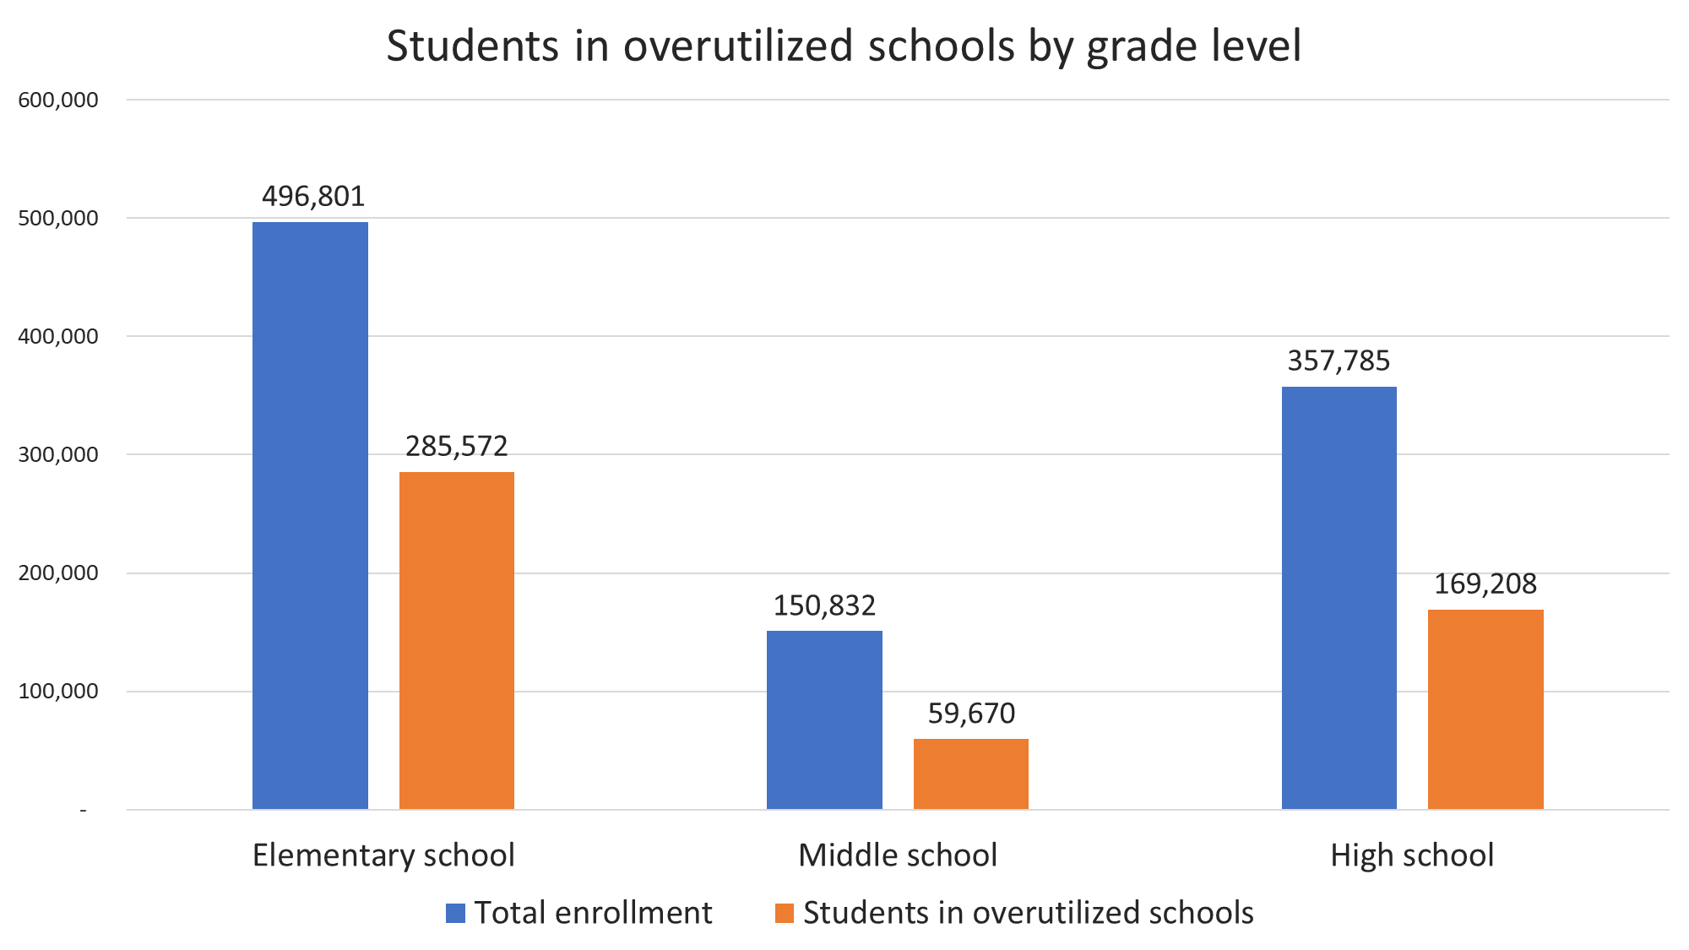
Source: 2018-2019 “Blue Book”

Slide 22
City Council Influence – Revenue Options
NYC & NYS is headed to revenue shortfalls of many billions of dollars as a result of pandemic
State government must approve any increases in city sales tax or income tax while city only controls increases in property tax rates and some fines/fees
State Legislature and Governor have been reluctant to approve tax increases though many bills to raise taxes on super wealthy & luxury goods (yachts, private planes, 2nd home pied-a-terre costing $5M or more, etc.)
Council can push for State to approve revenue increases via resolutions and lobbying the legislature

Slide 23
Council hearings & subpoena power
Among Council’s most important abilities is to hold hearings on critical issues , to demand answers from DOE and hear from constituents and stakeholder groups.
Yet often DOE doesn’t supply the answers during testimony even when provided questions in advance.
Council also has subpoena power, which it rarely uses.

Slide 24
City Council can pass Reporting Bills
City Council can mandate DOE reporting on class size, spending, disciplinary rates, segregation etc. Yet quite often DOE misses the deadlines on these reports or fails in other ways to comply with the law
For example:
Local Law 125 of 2015 requires annual class size reporting due each year by Nov. 15. and Feb. 15, but this year, DOE says will delay any class size reporting until Dec. 31 & won’t provide disaggregated data by learning modality until Feb. 15.
Local Law 167 of 2019 requires DOE to make methodology and data sources clear as to how they estimate need for new seats to eliminate overcrowding, disaggregated by sub–district and grade, but DOE hasn’t yet complied fully with the law.
Local Law 17 of 2019 created a Fair Student Funding Taskforce to give recommendations on how FSF formula should be revised in a report by Sept. 30, 2019 but still hasn’t released this report.
Notes:
More info on Local Law 167 is available here: https://www.classsizematters.org/local-law-167-168-information-and-memo-to-city-council/

Slide 25
Charter schools and contracts
Every year, more is spent on charter schools, this year costing DOE more than $2.4B per year with expanding enrollment; amount spent determined by state law.
DOE also increasing spending each year on contracts with companies to provide preK, busing, food services, online instruction, assessment & more
Council has exerted little oversight on DOE, which could hold hearings and demand more detailed reporting by law

Slide 26
Charter school facility spending
Class Size Matters released a report last year , showing that DOE spent more than $100M in FY 2019 on leasing space directly for charters or subsidizing their rent – as required by state law.
At same time, appeared to overpay these rent subsidies by $21 M dollars.
Also spent about $10 M dollars subsidizing rent for charters that owned their own buildings.
By law, public schools co-located with charters are supposed to receive matching funds for facility enhancements but were shorted by about $131 M between FY 2014 and FY 2019.
We are putting out a report soon with updated figures and more information directly from DOE’s response to the NYC Comptroller on these overpayments & shortfalls.

Slide 27
Testing
All public schools must administer state tests in grades 3-8 & once in HS as required by feds
In NYS, additional graduation exit exams called Regents are required
Last year because of COVID, the state received a federal waiver from administering the state tests; this year uncertain.
About 20% of eligible parents statewide opt out of the 3-8 grade state tests, w/ a smaller percent in NYC, b/c these tests, 3 days for ELA & 3 days for math, are considered onerous & unfair
In 2015, Council passed a resolution urging DOE to inform parents they have the right to opt out of 3-8 grade tests & include this info in the DOE Parent Bill of Rights, but this never happened.
Notes:
More info on CECs available here: https://www.schools.nyc.gov/get-involved/families/education-councils

Slide 28
City Council discretionary funding
Each year, Councilmembers receive funding to provide to non-profit groups that are doing important work in the form of reimbursable, discretionary contracts.
Members can also provide funding out of these allocations to schools in their districts to support special programs or services.
Members also have funds in the capital budget called Reso A funds they can donate to schools for certain projects, including repairs, equipment or facility upgrades.
Many community/advocacy groups like Class Size Matters depend on discretionary grants for a major part of their funding

Slide 29
Mayoral control
NYS Assembly is holding hearings on mayoral control on Dec. 17 amid increased dissatisfaction w/how the Mayor has handled school shutdowns during the pandemic.
Current system lapses in 2022, and though Council has no direct say as to whether Mayoral control will be renewed in an unchanged form or altered, they have opportunity to influence the Legislature through lobbying and resolutions.
Council under Speaker Chris Quinn supported “municipal control” – ie that DOE would be considered like any other city agency, and made subject to city law
Other possible reforms to provide more checks and balances & more public input:
Elected school board instead of appointed Panel for Ed Policy, as exists in rest of NY state & most of nation
Or PEP with additional members appointed by other elected officials so mayor no longer has a super-majority
More authority given to local elected Community Education Councils over school closings, co-locations, etc.
Hiring of an independent ombudsperson and/or Inspector General for enhanced accountability/transparency

Slide 30
For more information….
Contact Class Size Matters at info@classsizematters.org
Contact NYC Kids PAC at info@nyckidspac.org
Any questions?

